Slide 1
Efficient And Low Complexity Peak To Average Power Ratio Reduction Methods For Orthogonal Frequency Division Multiplexing Based Wireless System
By: Montadar Abas Taher (P54852)
Supervisors:
Dr. Mandeep Jit Singh
Prof. Mahamod Ismail
Prof. Salina Abdul Samad
Prof. MT Islam
Notes:
Add super visor list

Slide 2
Outlines
Introduction
Problem Statement
Literature Review
Objectives
Contributions
Methodology
Results & Discussion
Conclusion
Publications

Slide 3
Introduction
Orthogonal Frequency Division Multiplexing (OFDM) has become an important system for the new generations of telecommunications systems.
WiMAX, LTE, LTE-A are such examples of the systems that utilizes the OFDM signals.
Some limitations surround the usability of OFDM signals such as the PAPR, which put more limitations on the baseband mapping (PSK/QAM) or the complexity leading to a degradation in the BER-performance.
Notes:
No mentioning for the complexity or modulation/mapping technique or the BER

Slide 4
Serial
to
Parallel
IDFT
Parallel
to
Serial
Binary
Data
Source
M-QAM
or
M-PSK
Cyclic Prefix Insertion
RV-CR
SSLM
SI-SAC
Noisy
Channel
Parallel
to
Serial
DFT
Serial
to
Parallel
M-QAM
or
M-PSK
De-mapping
Binary
Data
Output
Cyclic Prefix Removal
Notes:
Highlight which part of the work

Slide 5
Systems that utilize the OFDM signals with different Mappings and symbol size
system | M |  |  | N
 | 4 | 16 | 64 | 64 | 128 | 256 | 512 | 1024 | 2048 | 4096
IEEE802.11a | × | × | × | × | - | - | - | - | - | -
IEEE802.11g | × | × | × | × | - | - | - | - | - | -
IEEE802.11n | × | × | × | × | × | - | - | - | - | -
IEEE802.15.3a | × | × | × | × | × | × | - | - | - | -
IEEE802.16a | × | × | × | - | - | × | - | × | - | -
IEEE802.16d | × | × | × | - | - | - | × | - | × | -
IEEE802.16e | × | × | × | - | - | - | - | - | × | -
DVB-T | × | × | × | - | - | - | - | - | × | ×
DVB-T2 | × | × | × | - | - | - | - | × | × | ×
DVB-H | × | × | × | - | - | - | - | - | × | ×
DVB-T/H | × | × | × | - | - | - | - | - | × | ×
3GPP-LTE/A | × | × | × | - | × | × | × | × | × | -
“×” : used
“-” : not used
Notes:
Define the dash and the cross with large font,

Slide 6
Problem Statement
The existing methods of PAPR reduction techniques introduce higher transceiver complexity.
Low complexity PAPR transceivers are not efficient and may produce side effects such as the degradation in the BER or the degradation in the PAPR reduction gain.
Although existing OFDM transceiver may be simple and efficient but only tailored and support certain modulation/mapping technique.

Slide 7
Example of design and target parameters
Required:
OFDM symbol size: N = 256,
Mapping order M = 16,
Target:
PAPR less than 12 dB,
Number of multiplication operations less than 9216,
Number of addition operations less than 18944,
BER degradation should be enhanced according to the scheme, such as AC should be corrected at max SNR = 12 db

Slide 8
Literature Review Study
Most famous approaches | Complexity | Adaptive modulation | Requires processing at transmitter (Tx) and receiver (Rx)
Amplitude Clipping (AC) (Mestdagh et al. 1993) | Medium | Yes | Tx: Amplitude clipping, filtering Rx: None
Armstrong 2002 (AC) | Very High | Yes | Recursive filtering
Deng & Lin 2007 (AC) | High | Yes | Optimizing the error for each subcarrier to reduce the BER
Constellation Reshaping (CR) (Kou et al. 2004) | Medium | No | Tx: Optimization Rx: None
Chau-Yun et al. 2006 (CR) | High | No | DFT-based constellation reshaping
Hsu & Chao 2008 (CR) | High | No | the approach should be jointly used with the SLM scheme
Selected Mapping (SLM) (Bauml et al. 1996) | High | Yes | Tx: U IDFTs Rx: Side information extraction, inverse SLM
Shih-Kai et al. 2011 (SLM) | High | Yes | Fountain PRVs
Chin-Liang et al. 2003 (SLM) | High | Yes | modifications in the IFFT function
SI-SAC (AC) | Low | yes | Tx: None Rx: None
SSLM (SLM) | Low | yes | Tx: None Rx: None
RV-CR (CR) | Very low | yes | Tx: None Rx: None
Notes:
Forget them

Slide 9
Objectives
To investigate the existing PAPR based reduction techniques for OFDM systems in terms of PAPR reduction gain and computational complexity.
To develop methods to reduce the PAPR in OFDM systems with minimal computational complexity. Furthermore, a balance between the computational complexity reduction, the PAPR reduction gain and the BER performance must be accomplished. As follows:
a) Side information supported amplitude clipping;
b) Sliding selected mapping; and
c) Random variable constellation reshaping.
Notes:
Suppose to be the same of the thesis

Slide 10
List of Contributions
New clipping method, a new equation for the soft limiter has been introduced.
New phase rotation mechanism, instead of multiple PRV, only one PRV was employed and the data will be slided over that only one PRV.
New constellation shaping method based on random variable transformation
Notes:
New clipping equation, more details about the new phase rotation

Slide 11
Methodology
This research adopts the following methodology. It is worth mentioning that all contributions of this work share a similar methodology as discussed below:
i. Defining the problem : The problem of the PAPR is explained in chapter II.
ii. Problem statement: According to the literature survey, the problem statement was formed and the conceptual approach and problem formulation will be done accordingly.
iii. Design specifications : The most important parameters that directly affect the PAPR values will be specified according to the standards. The standard parameters are shown as tables in chapters III
iv. Mathematical model : There are three novel techniques in this thesis; SI-SAC, SSLM, RV-CR. After specifying the design parameters, the mathematical formulation of each technique is developed.
v. Simulation model : Using the mathematical model in the fourth step, a simulation model was developed for each technique.
vi. Simulation and validation : The simulation and validation is to find the plots for the PAPR beside the BER-performance plots and PSD-performance plots.
vii. Performance analysis : The analysis of the performance is represented by the BER and PSD plots.

Slide 12
Methodology
Side information-supported amplitude clipping (SI-SAC)
In the conventional amplitude clipping scheme,
-The number of samples that are clipped is unknown,
-The original amplitudes of the clipped samples are also unknown.
For these reasons, we do not expect accurate values to be recovered at the receiver side without the use of expensive components in the transmitter and/or the receiver.

Slide 13
Side information-supported amplitude clipping (SI-SAC)
We propose a method to determine
-The number of samples that are clipped,
-The location of each clipped sample,
-The original amplitude of each clipped sample,
-to send these information as side information to the receiver,
such that the receiver could recover the original signal’s samples

Slide 14
Side information-supported amplitude clipping (SI-SAC)
Old-function
proposed-function
function clipped_ofdm=nclip(x,r)
N=length(x);
A=r*(P(x)); % clipping level r=1.28
x_clipped=abs(x);
for u=1:N
if x_clipped(u)>A
x_clipped(u)=A;
end
end
clipped_ofdm=x_clipped.*exp(1j*angle(x));
function [sinfo A clipped_ofdm]=clip(x,B,a)
N=length(x);
A=a*(P(x)); % clipping level= input back off
t=zeros(N,1);
x_clipped_index=find(abs(x)>=A);
x_clipped=abs(x);
x_clipped(x_clipped_index)=sqrt(x_clipped(x_clipped_index))/B;
t(x_clipped_index)=(x_clipped_index);
sinfo=t;
clipped_ofdm=x_clipped.*exp(1j*angle(x));

Slide 15
Sliding Selected Mapping (SSLM)
The major hindrances of SLM is the high computational complexity.
Thus, the number of IFFT blocks in the transmitter side will increase the computational complexity,
In other words, the number of additions and multiplications operations will be increased, therefore, the system will be not reliable.

Slide 16
PRV
Select Lower PAPR
IFFT
Select Lower PAPR
1st-shift
IFFT
Data from mapper
IFFT
Data from mapper
2ndshift
IFFT
2ndshift
IFFT
IFFT
n^{th}shift
IFFT
IFFT
Movement step size = r
Phase vector size = w=N.f
0<f<1
Optimize the phase sequences
function [si ofdms]=ssm(s,r,z)
%% input are
% s: original serial data
% r: step size
% z: window size
% outputs are:
% si: side information
% ofdms: OFDM symbol in serial format
N=length(s);
k_z8r4=z;
steps=r;
data=s;
k=k_z8r4;
L=N-k;
threshold=1000;
h=hadamard(k);
prv=h(k/2,:);
counter=0;
for r = 0:steps:L
counter=counter+1;
d2=[data(1:r) data(1+r:k+r).*prv data(k+r+1:end)];
dstp2=reshape(d2,N,1);
difft2=ifft(dstp2,N);
dpts5=reshape(difft2,1,N);
par_ss_z8r4=papr(dpts5);
if par_ss_z8r4<threshold
threshold=par_ss_z8r4;
index=r;
d_t=dpts5;
end
end
ofdms=d_t;
si=index;

Slide 17
Random Variable-Constellation Reshaping
Changing the point locations in a constellation diagram is critical; because of the minimum distance between the points must not change, or else, a large degradation in the BER performance may occur.
If it was possible to reshape the M-PSK family, or both M-(PSK/QAM), some side effects will appear such as a degradation in the BER performance, or maybe the computational complexity will be escalated up.

Slide 18
Random Variable-Constellation Reshaping
The key point of the proposed approach is:
an RV can be transformed to any other form by adding or subtracting constants to or from the RV or by adding two RVs together without affecting the PDF of the RVs
Hence, such transformation can be used as a method to put a novel constellation mapping fashion.

Slide 19
Random Variable-Constellation Reshaping
Assume two Gaussian RVs are and then,
thus, Z₃ is another normal random variable with mean and variance σ₃= σ₁+ σ₂. So, the probability density function of Z₃ can be expressed as,

Slide 20
Random Variable-Constellation Reshaping
Transmitter
Receiver
function [out par]=pifft(x,p)
N=length(x);
xp=reshape(x,N/p,p);
xpifft=fwht(xp);
out=reshape(xpifft,N,1);
par=papr2(out);
function out=pfft(x,p)
N=length(x);
xp=reshape(x,N/p,p);
xpifft=ifwht(xp); %fft
out=reshape(xpifft,N,1);

Slide 21
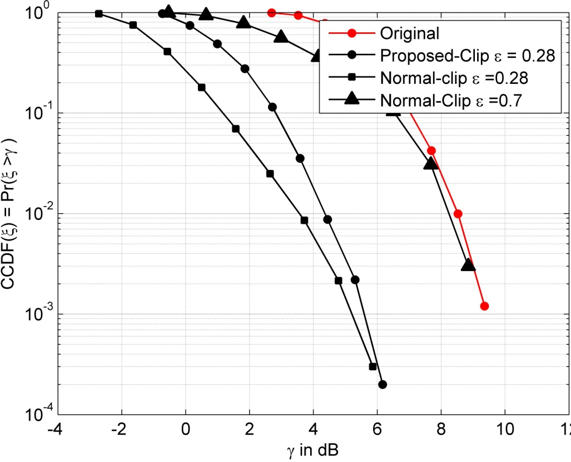
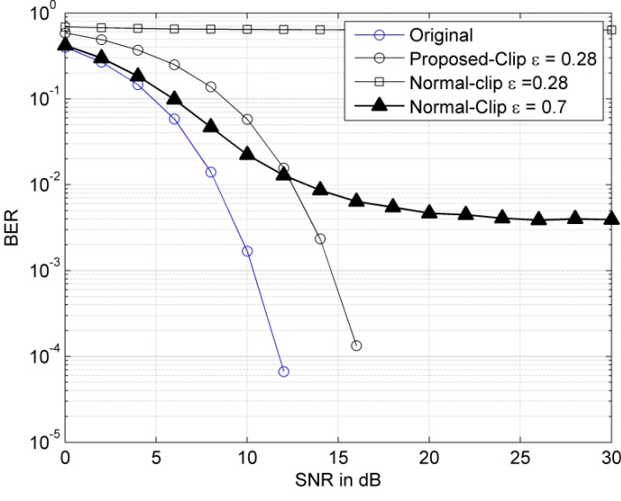
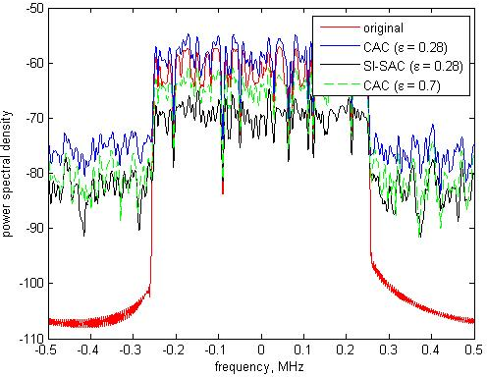
Results: (SI-SAC)
PAPR: N=64, M=16
BER: N=64, M=16

Slide 22
Side information supported amplitude clipping (SI-SAC)
N | CAC |  | SI-SAC |  | Armstrong 2002 |  | Deng & Lin 2007
64 | -- | -- | 25.93 | 25.93 | 61.58 | 94.11 | 80.58 | 97.09
128 | -- | -- | 30.16 | 30.16 | 63.64 | 94.12 | 81.59 | 97.08
256 | -- | -- | 33.33 | 33.33 | 65.22 | 94.12 | 82.35 | 97.06
512 | -- | -- | 35.8 | 35.8 | 66.45 | 94.12 | 82.95 | 97.05
1024 | -- | -- | 37.78 | 37.78 | 67.44 | 94.12 | 83.43 | 97.04
2048 | -- | -- | 39.39 | 39.39 | 68.25 | 94.12 | 83.83 | 97.035
4096 | -- | -- | 40.74 | 40.74 | 68.93 | 94.12 | 84.16 | 97.03
Notes:
Font must be larger, put title to the table

Slide 23
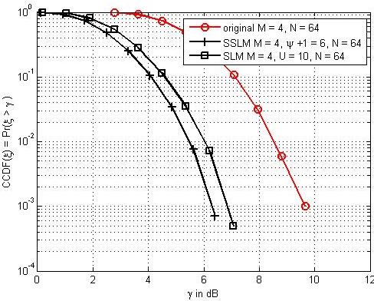
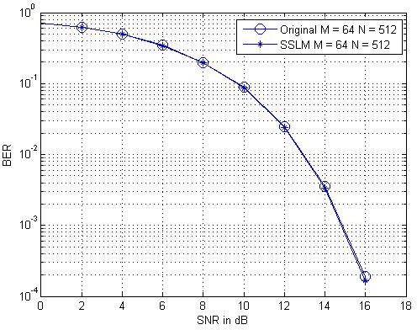
Results: (SSLM)

Slide 24
Sliding Selected Mapping (SSLM)
A: SSLM
B: CSLM
C: Jayalath et al 2000
D: Zhou et al 2004
E: Chin-Liang et al 2007
F: Irukulapati et al 2009
G: Shin-Kai et al 2011
N | A/A |  | A/B |  | A/C |  | A/D |  | A/E |  | A/F |  | A/G
64 | - | - | 40 | 40 | 40.49 | 40.25 | 45.45 | 45.45 | 63.07 | 47.93 | 40 | 40 | 40 | 40
128 | - | - | 40 | 40 | 40.42 | 40.21 | 45.45 | 45.45 | 52.67 | 43.67 | 40 | 40 | 40 | 40
256 | - | - | 40 | 40 | 40.37 | 40.18 | 45.45 | 45.45 | 46.29 | 41.66 | 40 | 40 | 40 | 40
512 | - | - | 40 | 40 | 40.33 | 40.16 | 45.45 | 45.45 | 42.97 | 40.75 | 40 | 40 | 40 | 40
1024 | - | - | 40 | 40 | 40.29 | 40.15 | 45.45 | 45.45 | 41.37 | 40.34 | 40 | 40 | 40 | 40
2048 | - | - | 40 | 40 | 40.27 | 40.13 | 45.45 | 45.45 | 40.63 | 40.15 | 40 | 40 | 40 | 40
4096 | - | - | 40 | 40 | 40.24 | 40.12 | 45.45 | 45.45 | 40.29 | 40.07 | 40 | 40 | 40 | 40

Slide 25
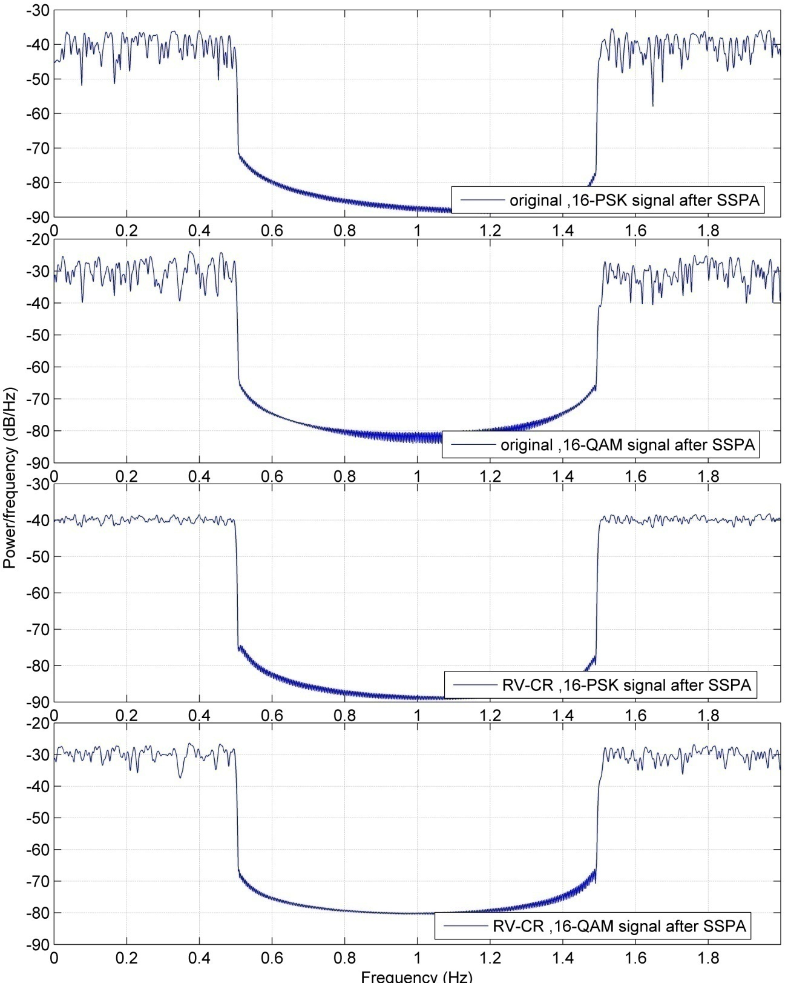
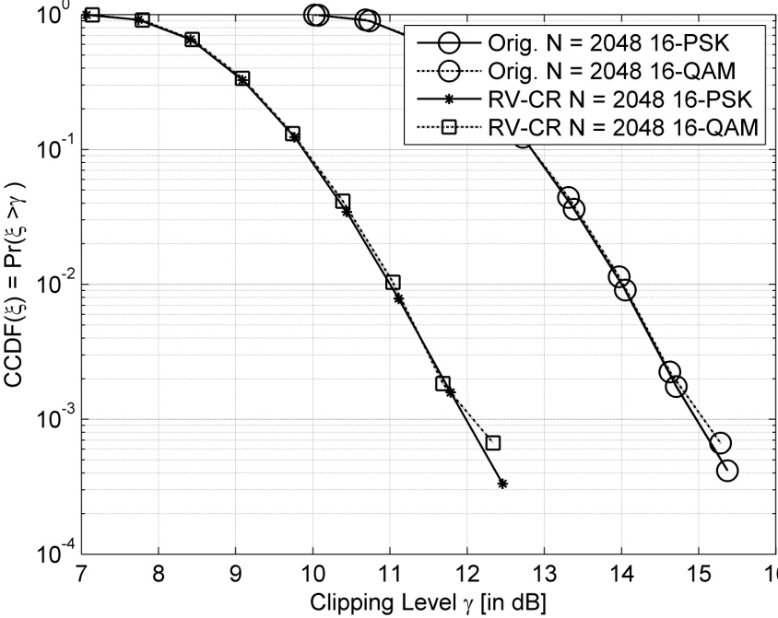
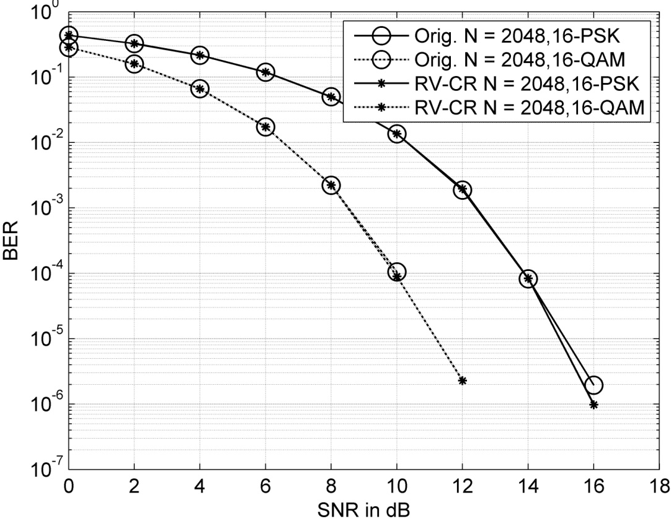
Results: (RV-CR)

Slide 26
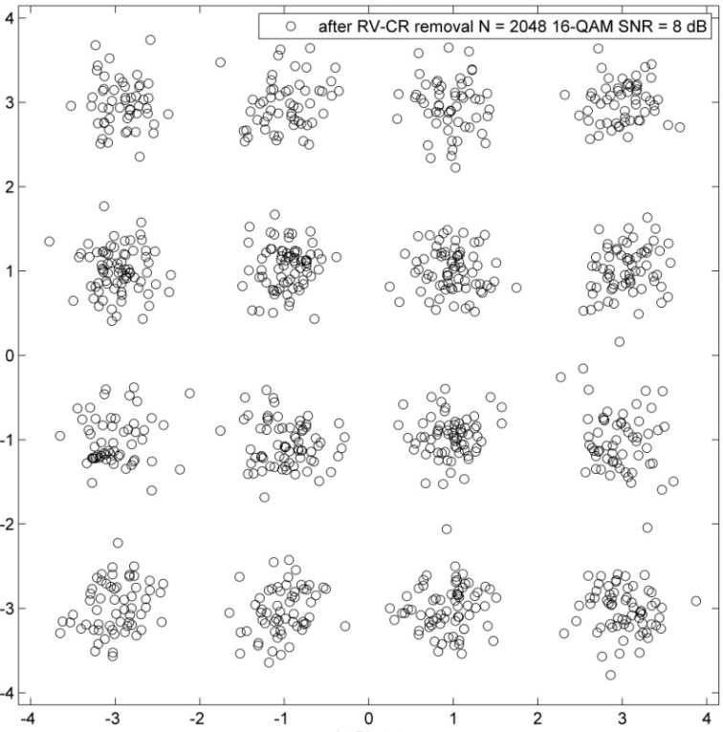
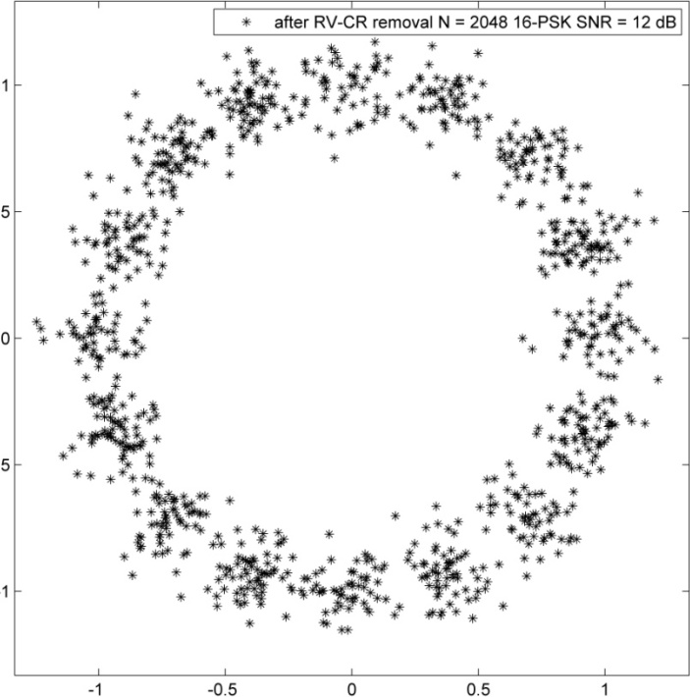
Results: (RV-CR)

Slide 27
Random Variable Constellation Reshaping (RV-CR)
N | A/A |  | A/B |  | A/C |  | A/D |  | A/E |  | A/F
64 | - | - | 100 | 66.66 | - | 83.33 | 100 | 98.68 | 100 | 97.91 | 100 | 97.92
128 | - | - | 100 | 71.42 | - | 85.71 | 100 | 98.83 | 100 | 98.21 | 100 | 98.22
256 | - | - | 100 | 75 | - | 87.5 | 100 | 98.95 | 100 | 98.43 | 100 | 98.44
512 | - | - | 100 | 77.77 | - | 88.88 | 100 | 99.05 | 100 | 98.61 | 100 | 98.61
1024 | - | - | 100 | 80 | - | 90 | 100 | 99.13 | 100 | 98.75 | 100 | 98.75
2048 | - | - | 100 | 81.81 | - | 90.90 | 100 | 99.20 | 100 | 98.86 | 100 | 98.86
4096 | - | - | 100 | 83.33 | - | 91.66 | 100 | 99.26 | 100 | 98.95 | 100 | 98.96
A: RV-CR
B: Chau-Yun et al. 2006
C: Mobasher & Khandani 2006
D: Hsu & Chao 2008
E: Yang & Tao 2009
F: Cai et al. 2011

Slide 28
Conclusions
The investigation for the existing PAPR based reduction techniques for OFDM systems in terms of PAPR reduction gain and computational complexity has been done.
Development of methods to reduce the PAPR in OFDM systems with minimal computational complexity has been achieved. Furthermore, the balance between the computational complexity reduction, the PAPR reduction gain and the BER performance has been accomplished. As follows:
a) Side information supported amplitude clipping;
b) Sliding selected mapping; and
c) Random variable constellation reshaping.
Notes:
This should be summary of the results, conclusion related to the study objectives

Slide 29
List of Publications: (Journals)
Montadar A. T., Singh, M.J., Ismail, M.B., Samad, S.A., Islam, M.T. Islam. 2013. Reducing the PAPR of OFDM systems by random variable transformation. ETRI Journal 35 (4): 714 – 717. SCOPUS/ISI-Q3
Montadar A. T., Singh, M.J., Ismail, M.B., Samad, S.A., Islam, M.T. Islam. 2013. Sliding the SLM-technique to reduce the non-linear distortion in OFDM systems. Elektronika ir Elektrotechnika 19(5): 03 – 111 . SCOPUS/ISI-Q4
Montadar A. T., Singh, M.J., Ismail, M.B., Samad, S.A., Islam, M.T. Islam. 2013. Reducing the power envelope fluctuation of OFDM systems using side information supported amplitude clipping approach. International Journal of Circuit Theory and Applications. SCOPUS/ISI-Q2
Montadar A. T., Singh, M.J., Ismail, M.B., Samad, S.A., Islam, M.T. Islam, Hussain F. M., 2014. Post-IFFT-Modified Selected Mapping to Reduce the PAPR of an OFDM System. Circuits, Systems, and Signal Processing . SCOPUS/ISI-Q2
Montadar A. T., Singh, M.J., Ismail, M.B., Samad, S.A., Islam, M.T. Islam. 2012. Peak to average power ratio reduction of orthogonal frequency division multiplexing system with a significant low complexity. American Journal of Applied Sciences 9(12): 1985 - 1989. SCOPUS
Montadar A. T., Singh, M.J., Ismail, M.B., Samad, S.A., Islam, M.T. Islam. 2012. An additive scaling factor to reduce the PAPR of the OFDM systems. Journal of Electrical and Electronics Engineering 5(1): 247 – 250. SCOPUS
Montadar A. T., Singh, M.J., Ismail, M.B., Samad, S.A., Islam, M.T. Islam. 2012. A novel way to enhance the PAPR of OFDM systems. Journal of Applied Sciences Research 8(3): 1589 - 1593 . SCOPUS
RV-CR
SSLM
SI-SAC
PI-MSLM

Slide 30
List of Publications: (Conferences)
Montadar A. T., Singh, M.J., Ismail, M.B., Samad, S.A., Islam, M.T. Islam. 2011. Amplitude phase grouping algorithm to enhance the PAPR problem. 7th International Conference on Information Technology and Application, (ICITA 2011) 245 – 248.
Montadar A. T., Singh, M.J., Ismail, M.B., Samad, S.A., Islam, M.T. Islam. 2011. Blind technique to lower the PAPR of the MC-CDMA system without complexity. 17th Asia-Pacific Conference on Communications, (APCC 2011) 688 – 691.
Montadar A. T., Singh, M.J., Ismail, M.B., Samad, S.A., Islam, M.T. Islam. 2011. A novel simple algorithm to enhance the peak to average ratio of MC-CDMA system. 2011 IEEE International Conference on Signal and Image Processing Applications, (ICSIPA 2011) 324 - 326

Slide 31
Thank You

